Slide 1
IGGI Module AI Informed Game Design
Diego Perez and Simon Lucas
with Ivan Bravi, Vanessa Volz, Mike Cook and Simon Colton

Slide 2
AI + AI Informed Game Design
How can we design and deploy AI in games
as opponents, collaborators, testers
How can AI be used to make better games?
Set design objectives
Then try to meet them
Measure activity of a range of AI bots
What aspects of bot activity predict human experience?
The course will be taught with a mixture of lectures, labs (including game AI competitions) and group work
Notes:
What does better mean?

Slide 3
What you might do …
Design a simple new game or modify an existing one
Spice it up with some new features
Test and tune them with agent-based AI
OR tune a range of AI agents to enhance a 2-player game with interesting opponents

Slide 4
Main Topics
General and easily applied AI Agent Algorithms via Statistical Forward Planning (SFP)
Rolling Horizon Evolution
Monte Carlo Tree Search
Game Design Spaces
Design, Implementation and Testing
What to optimise
And how to measure it and form Objective Functions
Sample Efficient Noisy Optimisation
Important for Game Tuning
And AI Agent Tuning
We’ll use the N-Tuple Bandit Evolutionary Algorithm (NTBEA)
Mini AI Competition
Notes:
These SFP algorithms are a game changer – they enable general good performance AI across a wide range of games WITHOUT the need for any tuning!

Slide 5
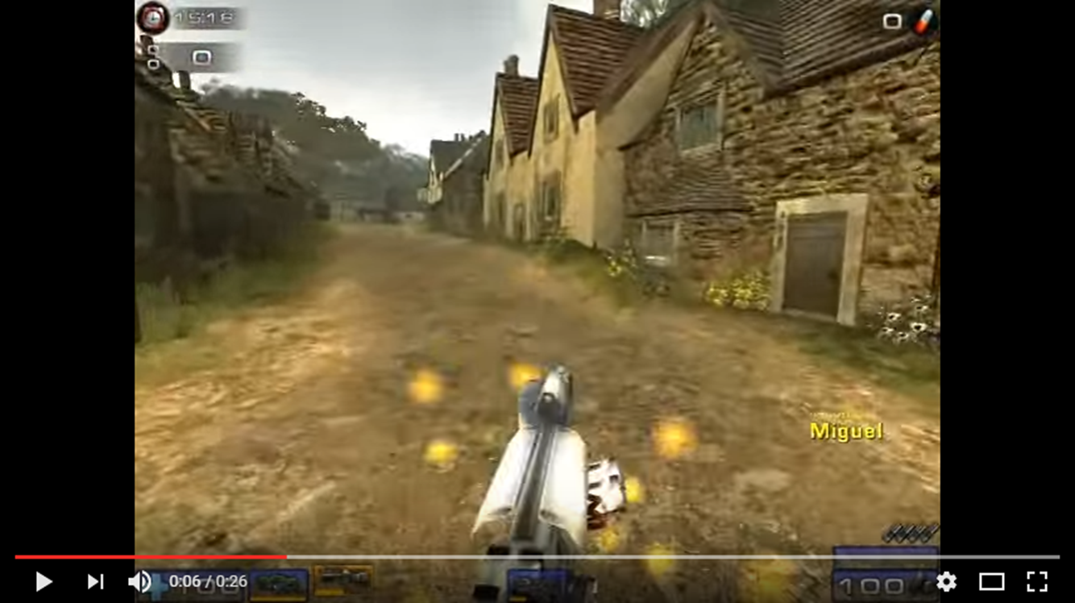
Applications of Adaptive Game AI
Instant high quality opponents and / or collaborators
No programming of the agent needed – just ensure that the game implements a standard interface
Can train them to be more human-like e.g2k Bot Prize (unreal tournament)
Automated play testing of games
Can invent new games easily!
Picking the good ones is the trickier part…
Adaptive AI can help
Measure drama
Measure skill
Can “good” players beat random players
Use league results as evidence of skill depth

Slide 6
Automated or AI Assisted Game Design
An exciting topic in Game AI and in Computational Creativity
Can an algorithm automatically design novel high quality games, or game levels?
Or perhaps choose good parameters for an existing game?
Work in this area has been around for a while
But with better general purpose AI, is really starting to take off now

Slide 7
Automated Game Design: Main Steps and Challenges
Main steps:
Creating a search space for a set of games (or game levels)
Creating operators to choose points in the space, and also variation operators to choose points in some neighbourhood (e.g. a Mutation operator)
Evaluate points in the search space
In general, the final step (evaluation) is the hardest!
For a restricted set of games, we can write evaluation heuristics
Or measure the experience of AI bots …

Slide 8
Guest Speakers

Slide 9
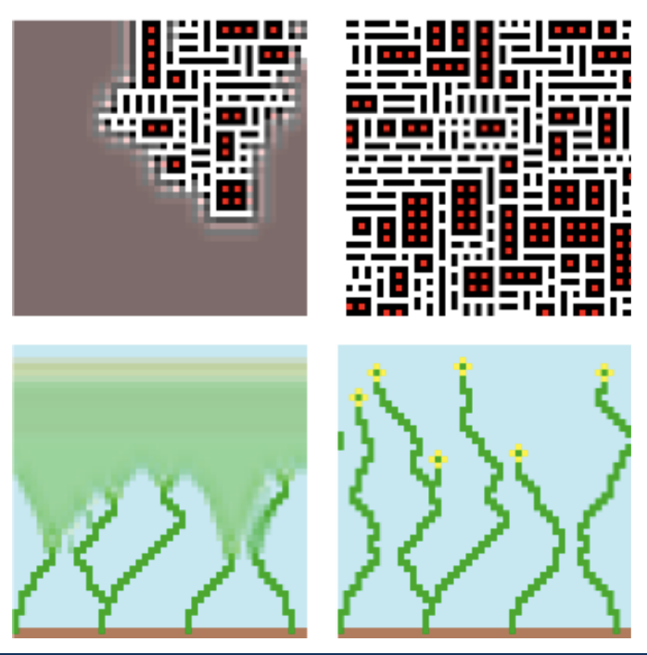
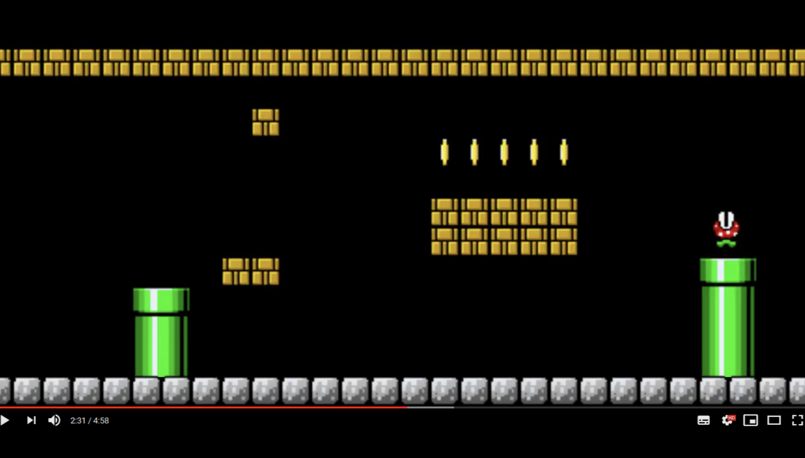
Vanessa Volz: PCG

Slide 10
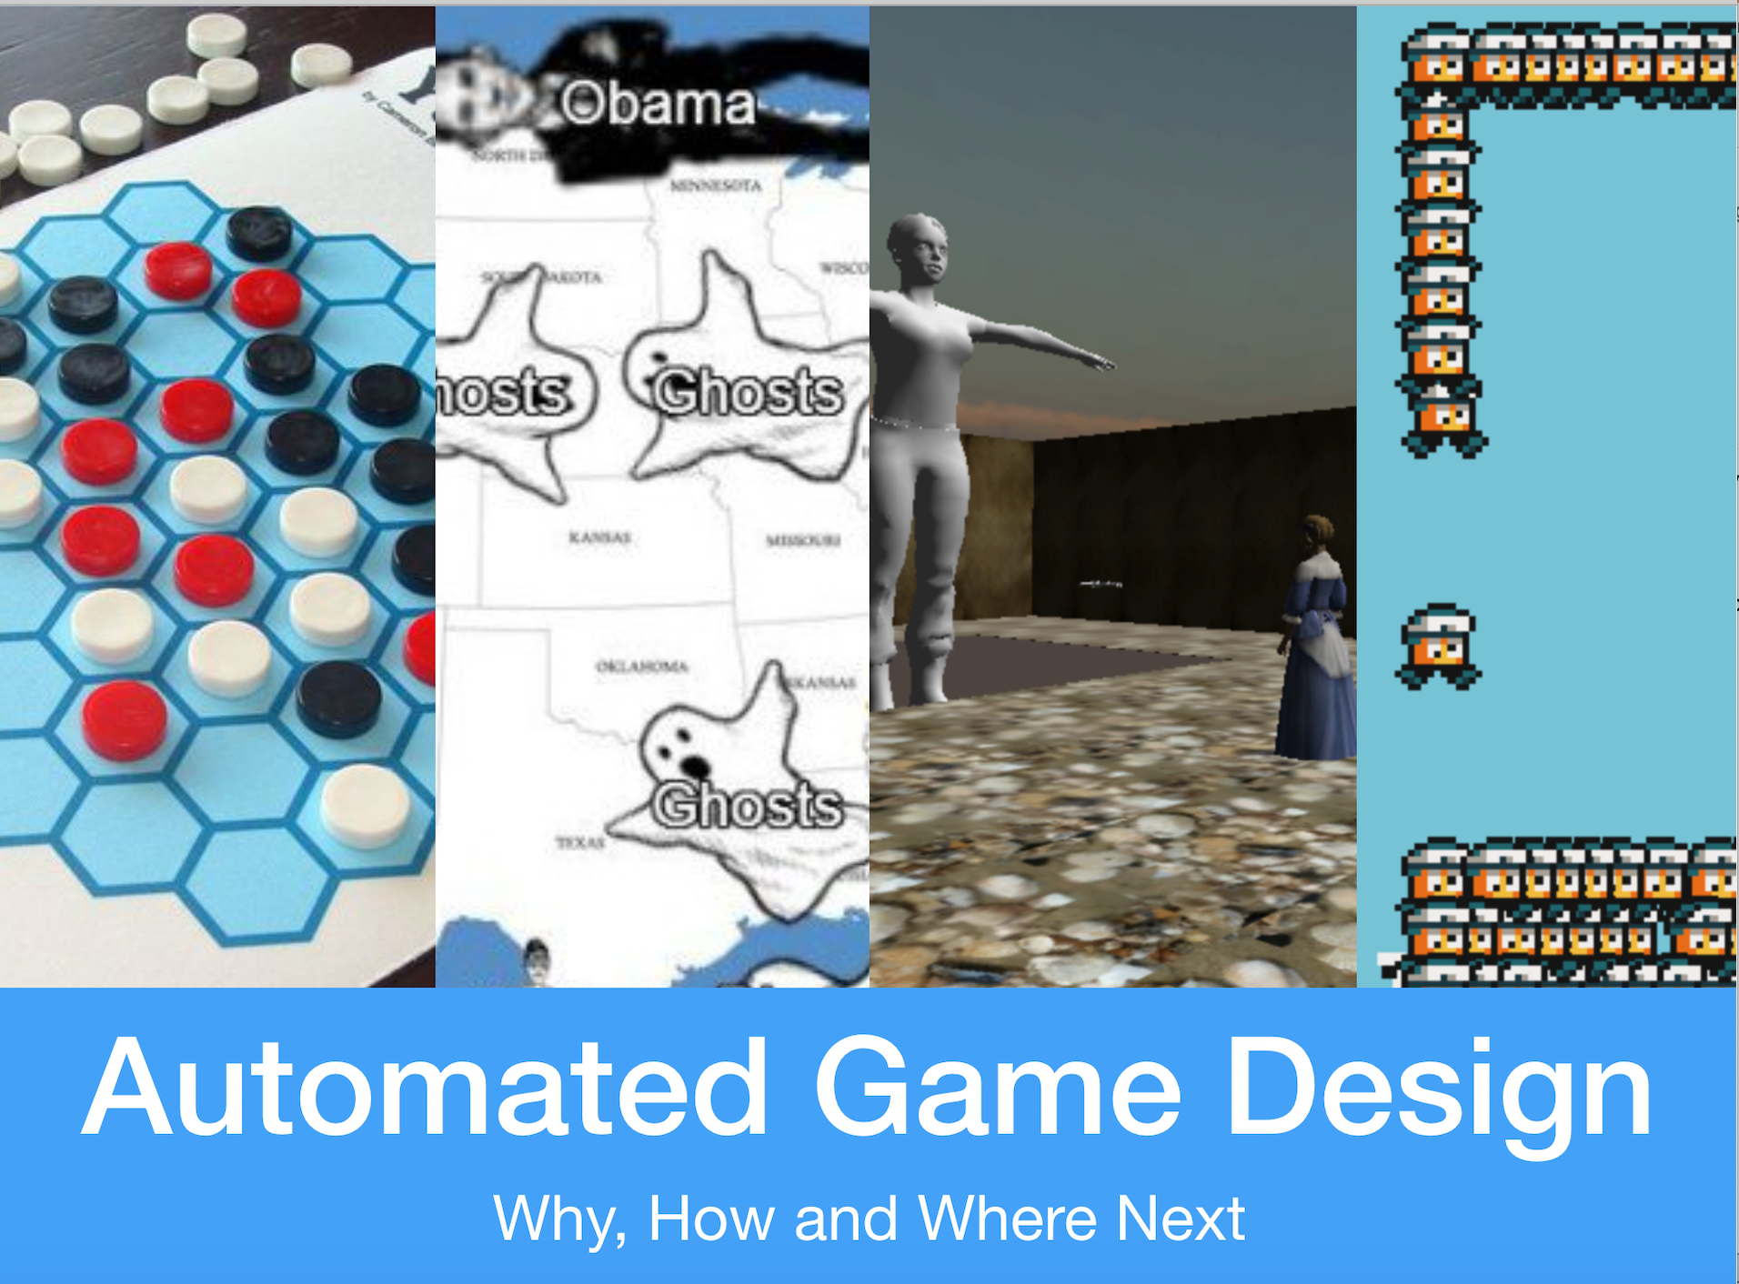
Mike Cook:

Slide 11
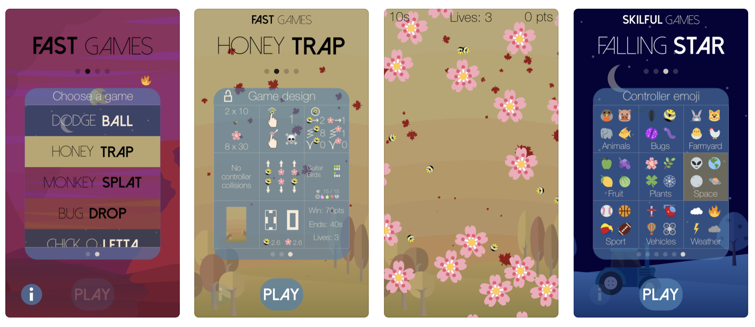
Simon Colton: Casual Creators

Slide 12
Questions?

